Slide 1
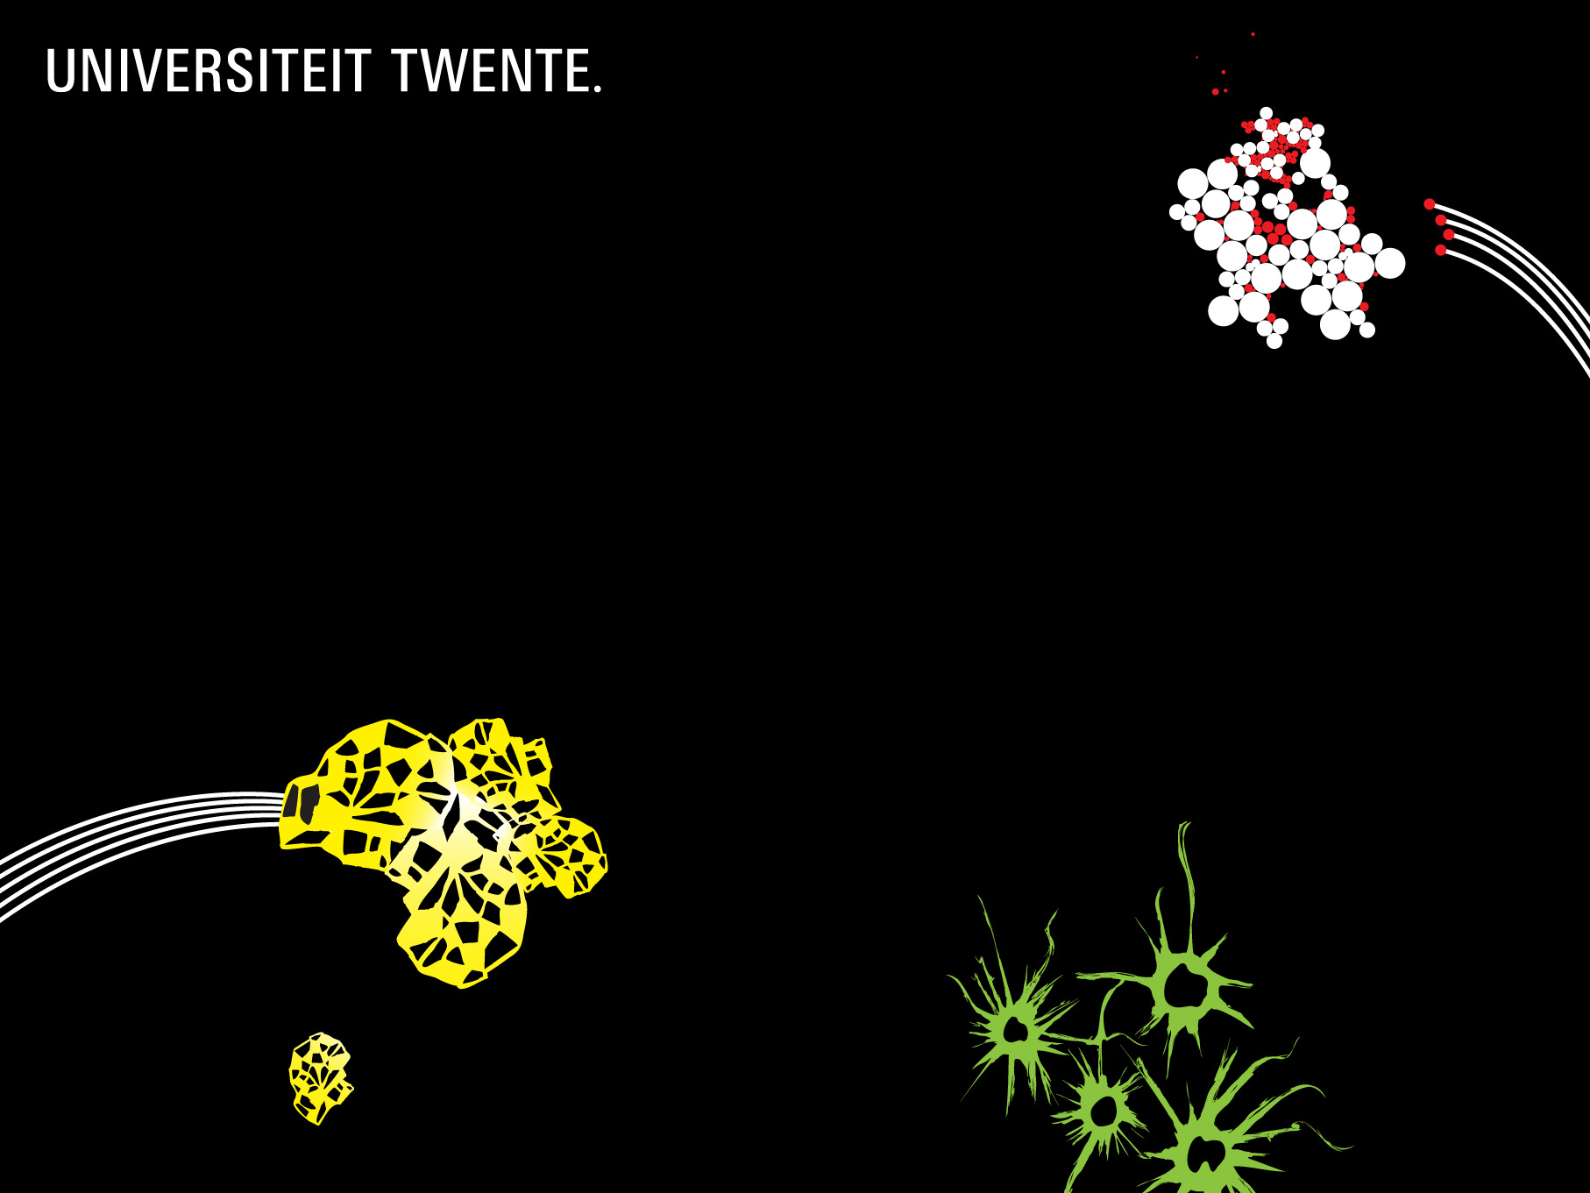
Handling uncertainty in information extraction
Maurice van Keulen and Mena Badieh Habib
URSW
23 Oct 2011

Slide 2
information extraction
Unstructured Text
Information extraction
Web of Data
Inherently imperfect process
Word “Paris”
First name? City? …
City => over 60 cities “Paris”
Toponyms: 46% >2 refs
source: GeoNames
“We humans happily deal with doubt and misinterpretation every day;
Why shouldn’t computers?”
Goal: Technology to support the development of
domain specific information extractors

Slide 3
sherlock holmes-style information extraction
“when you have eliminated the impossible, whatever remains,
however improbable, must be the truth”
Information extraction is about gathering enough evidence to decide upon a certain combination of annotations among many possible ones
Evidence comes from ML + developer (generic) + end user (instances)
Annotations are uncertain
Maintain alternatives + probabilities throughout process (incl. result)
Unconventional starting point
Not “no annotations”, but “no knowledge, hence anything is possible”
Developer interactively defines information extractor until “good enough”
Iterations: Add knowledge, apply to sample texts, evaluate result
Scalability for storage, querying, manipulation of annotations
From my own field (databases): Probabilistic databases?

Slide 4
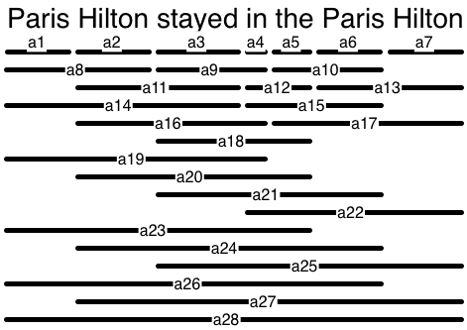
sherlock holmes-style information extraction
example: Named entity recognition (NEr)
“when you have eliminated the impossible, whatever remains,
however improbable, must be the truth”
dnc
Person
Toponym
dnc
isa
City
inter-actively
defined
Notes:
Any combination of annotations is an “interpretation”

Slide 5
sherlock holmes-style information extraction
example: Named entity recognition (NEr)
|A|=O(klt) linear?!?
k: length of string
l: maximum length phrases considered
t: number of entity types
Here: 28 * 3 = 84 possible annotations
URSW call for papers
about 1300 words
say 20 types
say max length 6 (I saw one with 5)
= roughly 1300 * 20 * 6
= roughly 156,000 possible annotations
Although
conceptual/theoretical,
it doesn’t seem to be a severe challenge for a probabilistic database
The problem is not in the amount of alternative annotations!

Slide 6
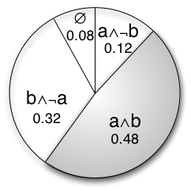
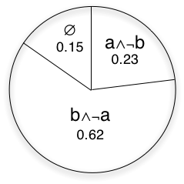
adding knowledge = conditioning
Paris Hilton stayed in the Paris Hilton
a and b
independent
P(a)=0.6
P(b)=0.8
a and b
mutually
exclusive
(a∧b is not
possible)
Person --- dnc --- City
x₁² (“Paris” is a City) [a]
x₈¹ (“Paris Hilton” is a Person) [b]
become mutually exclusive

Slide 7
Adding knowledge creates dependencies
number of deps magnitudes in size smaller than possible combinations
Paris
Hilton
stayed
Person
City
dnc
Person
dnc
neq
City
dnc
8
+8
+15

Slide 8
problem and solution directions
I’m looking for a scalable approach to reason and redistribute probability mass considering all these dependencies to find the remaining possible interpretations and their probabilities
Feasibility approach hinges on efficient representation and conditioning of probabilistic dependencies
Solution directions (in my own field):
  Koch etal VLDB 2008 (Conditioning in MayBMS)
  Getoor etal VLDB 2008 (Shared correlations)
This is not about only learning a joint probability distribution.
Here I’d like to estimate a joint probability distribution based on initial independent observations and then batch-by-batch add constraints/dependencies and recalculate
Techniques out there that fit this problem?
Questions / Suggestions?

